Slide 1


Use PowerPoint a lot?
This two-minute video can save you a ton of time!

Slide 3
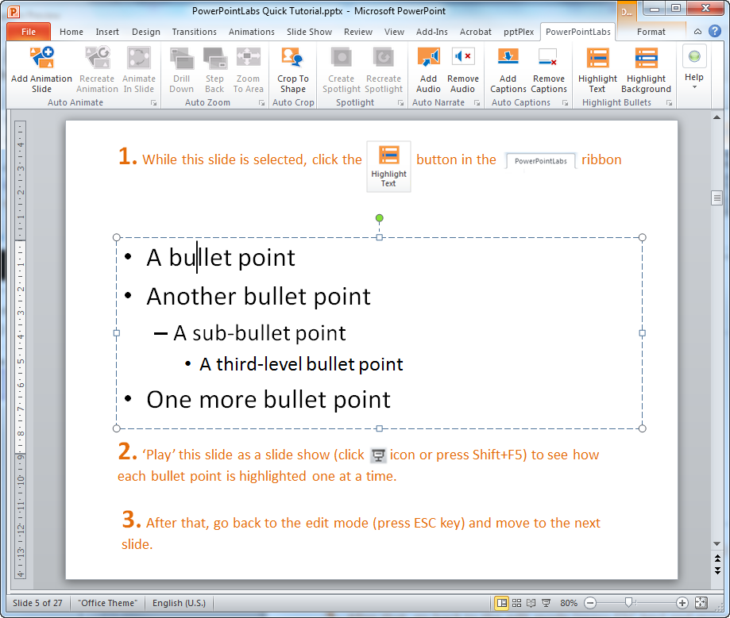
To indicate which point you are describing:
A bullet point
Another bullet point
A sub-bullet point
A third-level bullet point
One more bullet point

Slide 4


To indicate which point you are describing:
The result
A bullet point
Another bullet point
A sub-bullet point
A third-level bullet point
One more bullet point

Slide 5
To indicate which point you are describing:
A bullet point
Another bullet point
A sub-bullet point
A third-level bullet point
One more bullet point

Slide 6
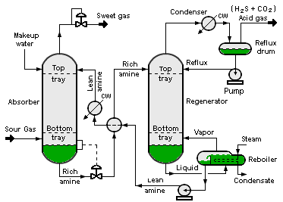

To show which part of the slide you are describing:
Draw shapes for areas you plan to describe
Animate in Slide
Image credit: Wikipedia

Slide 7
To show which part of the slide you are describing:
Draw shapes for areas you plan to describe
Animate in Slide
Image credit: Wikipedia

Slide 8
To show which part of the slide you are describing:
Works with other shapes too
Animate in Slide

Slide 9
To show which part of the slide you are describing:
Or you can create spotlight effects to highlight areas
Create Spotlight

Slide 10



To show which part of the slide you are describing:
Or you can create spotlight effects to highlight areas
Create Spotlight

Slide 11
To create complex animations:
Create one slide with shapes in the start positions

Slide 12
To create complex animations:
Create one slide with shapes in the start positions
Create another slide with shapes in the end positions
Add Animation slide

Slide 13
To create complex animations:
Create one slide with shapes in the start positions
Create another slide with shapes in the end positions
Add Animation slide

Slide 14
To create complex animations:
Create one slide with shapes in the start positions
Create another slide with shapes in the start positions
Add Animation slide

Slide 15
To create complex animations:
Create one slide with shapes in the start positions
Create another slide with shapes in the end positions
Add Animation slide

Slide 16
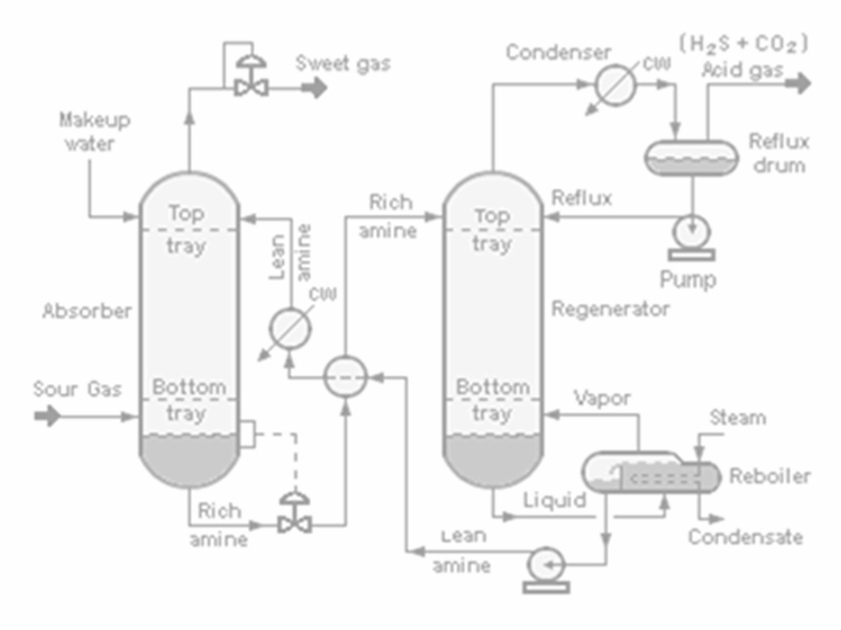
To zoom into different areas of the slide:
Draw rectangles to mark areas to zoom into
Zoom to Area

Slide 17
To zoom into different areas of the slide:
Draw rectangles to mark areas to zoom into
Zoom to Area

Slide 18
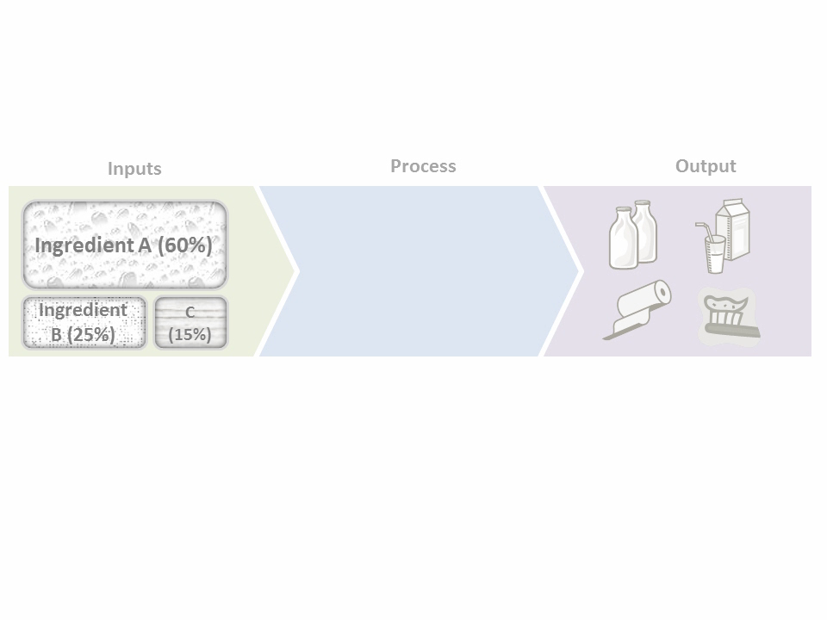


To zoom into different areas of the slide:
More advanced zoom in/out to show drill down and step back effects
Drill down
Step back

Slide 19
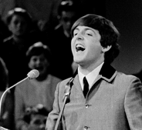
To show only a part of a picture:
Draw a shape to mark the area you want to cut out
A great quote said by
-a known person
Crop to Shape
Image credit: Wikipedia

Slide 20

To show only a part of a picture:
A great quote said by
-a known person
Crop to Shape

Slide 21
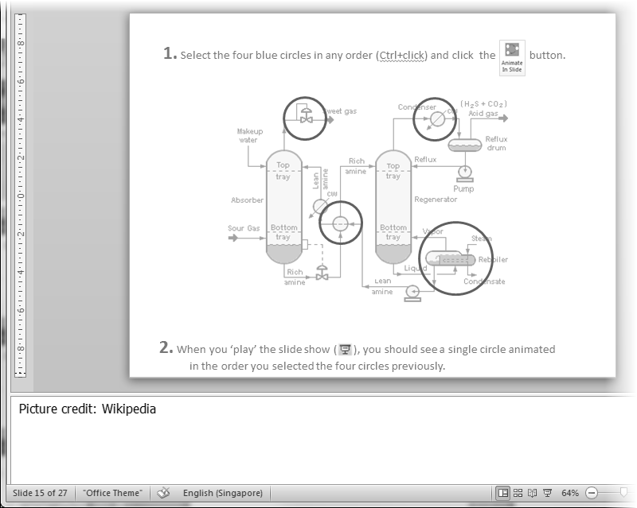
To add explanatory captions to self-study slides:
Add Captions
Type your explanations in the slide notes
Your explanations for the slide.
More explanations.

Slide 22
To add explanatory captions to self-study slides:
Add Captions
Animated captions added to slides automatically
Your explanations for the slide.
More explanations.

Slide 23
To generate audio narrations for slides:
Add Audio
Type what you want to ‘say’ in slide notes
Your explanations for the slide.

Slide 24
To generate audio narrations for slides:
Audio narration generated and embedded in the slide
Add Audio
Type what you want to ‘say’ in slide notes
Your explanations for the slide

Slide 25
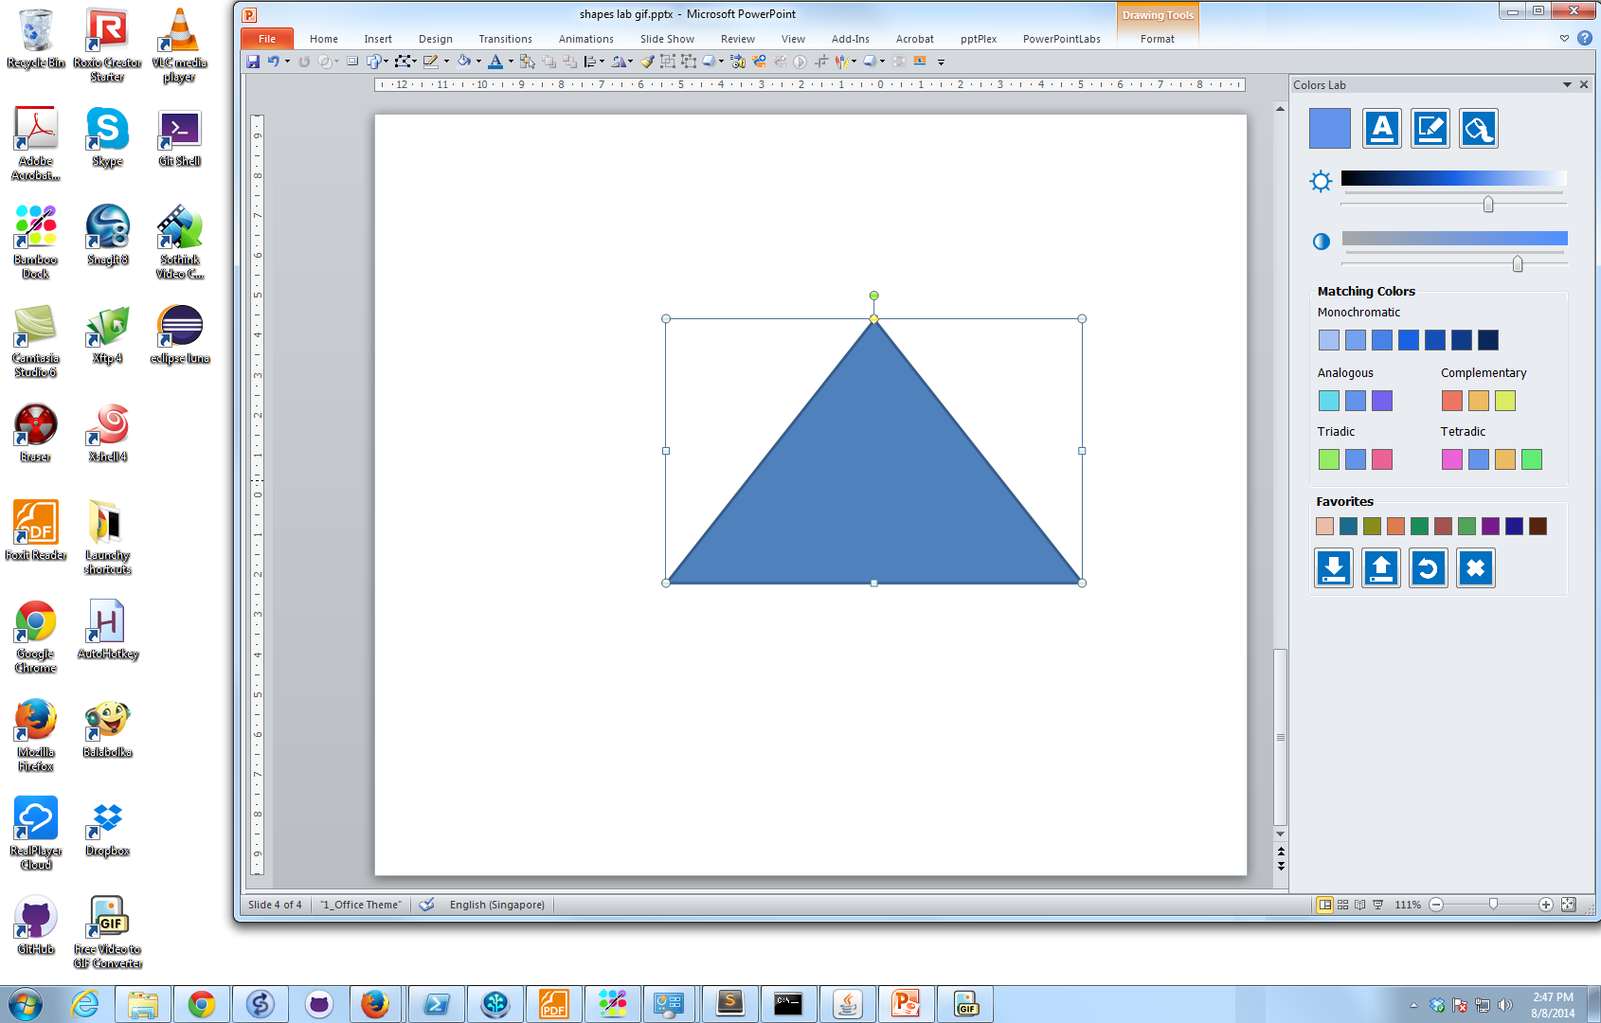


To pick colors from surroundings:
Pick colors from anywhere on the screen
Colors Lab

Slide 26

To pick colors from surroundings:
Pick colors from anywhere on the screen
Colors Lab
Catchy slogan!
Catchy slogan!
Catchy slogan!
Live preview

Slide 27
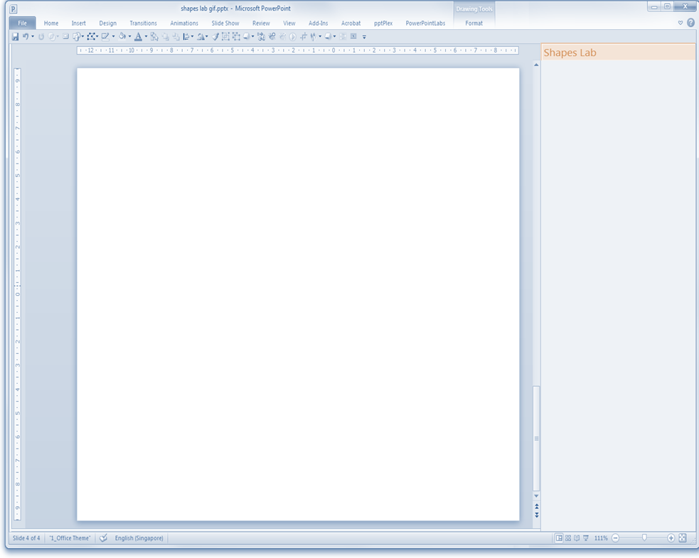

Save and reuse shapes:
Shapes Lab
Save shapes for later use

Slide 28
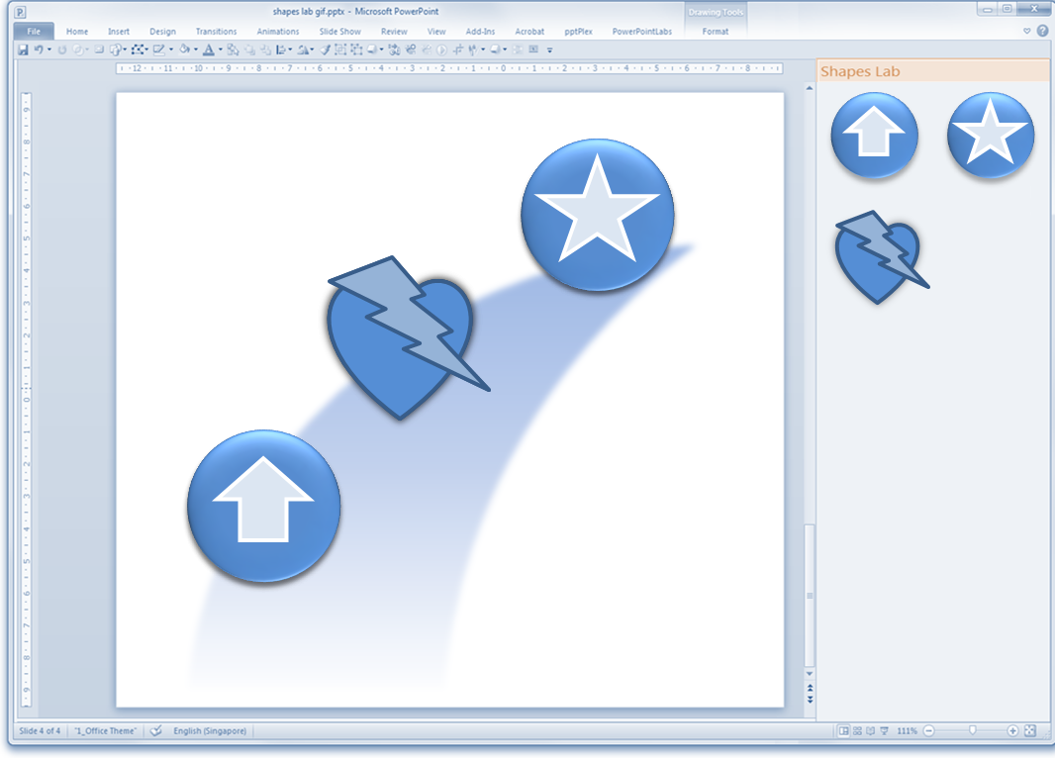
Save and reuse shapes:

Slide 29
Save and reuse shapes:
Shapes Lab
Save shapes for later use

Slide 30
Save and reuse shapes:
Shapes Lab
Save shapes for later use
Reuse in other presentations

Slide 31

This video was created using PowerPointLabs
A free add-in for PowerPoint 2010 and 2013
This video was created using PowerPointLabs
Get it from http://PowerPointLabs.info

Slide 32
Title: Use PowerPoint a lot? This two-minute video will save you a ton of time.
Description:
Use PowerPoint a lot? This two-minute video will save you a ton of time. A feature demo of the free PowerPointLabs add-in for Microsoft PowerPoint 2010 and 2013.
Keywords:
Microsoft PowerPoint
presentation
Free
Add-in
plugin demo zoom crop animate spotlight highlight pick colors save shapes

